Slide 1

UNIVERSITY COLLEGE OF ENGINEERING VILLUPURAM
(A Constituent College of Anna University, Chennai)
DEPARTMENT OF INFORMATION TECHNOLOGY - 2025
RISK AND STAGE CLASSIFICATION OF NAFLD-HCC PATIENTS USING XGBOOST MODEL
SECOND REVIEW
GUIDED BY :
MR.SATHEESH KUMAR N,
Department of Information Technology,
UCEV .
PRESENTED BY:
LEENA S (422521205019),
RITHIKA MS (422521205033),
SASANIYA S (422521205039),
SWETHA U (422521205044).

Slide 2
AGENDA
Introduction
Abstract
Literature Review
Existing System
Existing System Architecture
Proposed Work
Proposed Work Architecture
Modules Introduction
Modules Implementation
Model Evaluation
Results & Graphs
References

Slide 3
Introduction
This project uses machine learning to detect not only whether a patient might survive but also the stage of their disease.
It allows users to upload their own data and get real-time results with easy-to-understand visuals like charts and reports.
The system is designed to be interactive, so users can explore the detections in detail.
It also uses two powerful models to make the detections more accurate and reliable.

Slide 4
Abstract
This project enhances traditional mortality prediction models by introducing disease stage prediction and real-time user interaction. It features a dual-model architecture, improved data preprocessing, and interactive visualizations for better usability. Built using Python and libraries like scikit-learn and XGBoost, it supports dynamic CSV-based predictions.

Slide 5
Literature Review
S.NO | TITLE | AUTHOUR & YEAR | OBJECTIVES | TECHNIQUES USED | KEY FINDINGS
1. | Machine Learning-Based Assessment of Survival and Risk Factors in NAFLD-Related HCC (Base Paper) | Suárez M. et al., 2024 | Predict survival and risk factors in NAFLD-HCC patients | XGBoost (ML), Clinical Data Analysis | Alcohol, obesity, and cirrhosis affect prognosis; XGBoost had higher accuracy
2. | Preoperative Prediction for Early Recurrence of HCC Using ML-Based Radiomics | Mao B. et al., 2024 | Predict early recurrence of HCC after surgery | Radiomics (CT), Machine Learning | Combined radiomics + clinical data improved accuracy
3. | Prediction of Response to DEB-TACE in HCC Using CT Radiomics | Zhang X. et al., 2024 | Predict how patients respond to first DEB-TACE treatment | Logistic Regression, CT Radiomics + Clinical Data | Integrated model achieved best performance

Slide 6
Literature Review(Cont…)
S.NO | TITLE | AUTHOURS & YEAR | OBJECTIVES | TECHNIQUES USED | KEY FINDINGS
4. | Development of a ML-Based Prognostic Model for AFP-positive HCC | Dong B. et al., 2024 | Predict 1-, 3-, and 5-year survival for AFP+ HCC patients | XGBoost, LR, SVM, RF, KNN, ID3 | XGBoost outperformed all other models; 5-year
5. | Centrosome Amplification Signature Predicts Prognosis & Drug Response in HCC | Liu Y. et al., 2024 | Use CARGs to improve HCC diagnosis and therapy prediction | LASSO-Cox Regression, Single-cell RNA-seq | 6-gene signature linked to recurrence, immune evasion & drug sensitivity

Slide 7
Existing System
The existing system uses an XGBoost-based machine learning model to predict survival and identify key risk factors in NAFLD-related HCC patients. Trained on multicenter data with Bayesian optimization, it outperforms other models in accuracy. Key predictors include alcohol use, obesity, and cirrhosis, aiding personalized patient management.

Slide 8
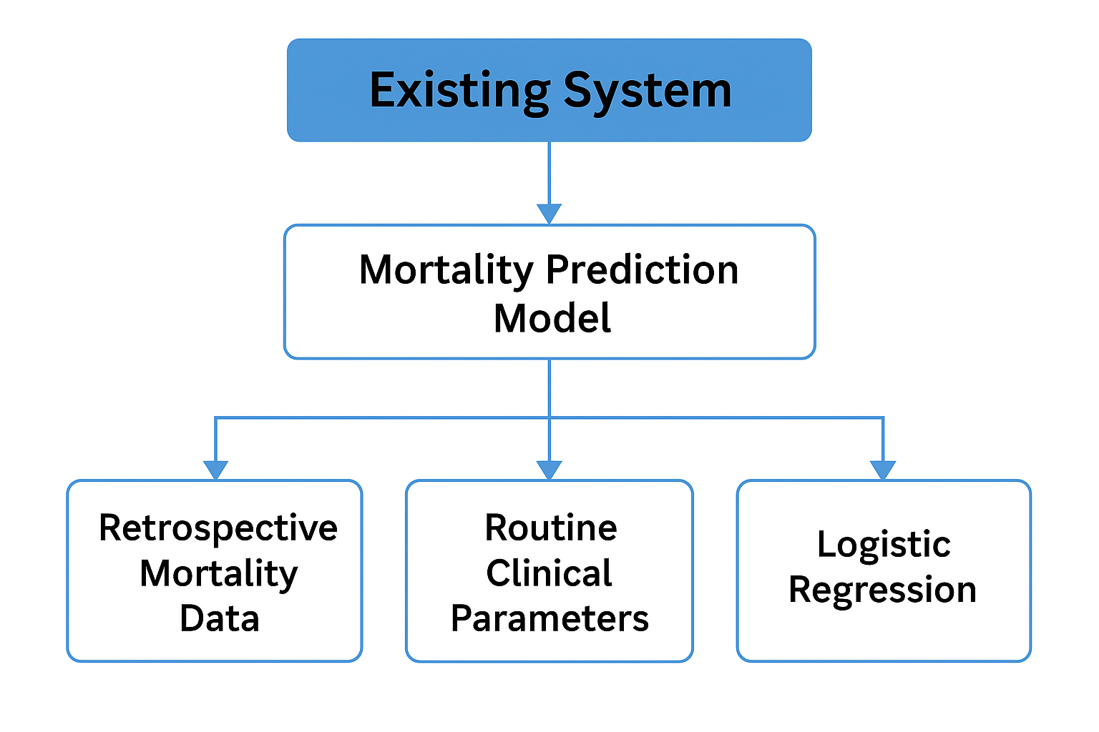
Existing System Architecture

Slide 9
Current Issues
Only mortality prediction was implemented
No user interaction or real-time prediction support
Limited model evaluation
Basic data handling
No dual-model structure
Poor explainability for users

Slide 10
Proposed Work
Develop two machine learning models:
Mortality Prediction (Alive/Deceased – Binary Classification)
Disease Stage Prediction (Early, Intermediate, Advanced – Multiclass Classification)
Implement real-time prediction capability using CSV file upload.
Perform data preprocessing:
Convert status to binary
Derive disease stage from survival time
Apply feature scaling with StandardScaler

Slide 11
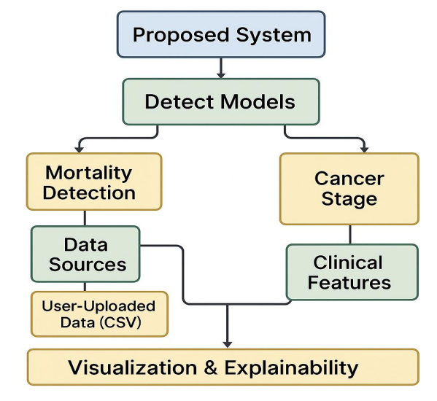
Proposed Work Architecture

Slide 12
Modules Introduction
Data Collection & Preprocessing:
Handled missing values using Mean/Median imputation
Removed outliers
Feature scaling applied (StandardScaler)
Converted categorical values using One-Hot Encoding
Label Engineering:
Converted "status" to binary for mortality prediction
Derived disease stage (Early, Intermediate, Advanced) from survival time

Slide 13
Modules Introduction(Cont…)
Model Development:
Built two models:
Binary Classification for Mortality
Multiclass Classification for Disease Stage
Used XGBoost algorithm with tuned hyperparameters
Real-Time Prediction Interface:
Integrated CSV file upload and download in Google Colab
Automated prediction outputs and visualizations

Slide 14
Modules Introduction(Cont…)
Evaluation & Visualization:
Generated Confusion Matrix and Classification Reports
Compared metrics like Precision, Recall, and F1-Score
Achieved high accuracy and reduced false negatives

Slide 15
Tools Installation
Programming Language:
Python
Libraries:
Xgboost ,scikit-learn, pandas, matplotlib ,seaborn ,fpdf
Tools:
Google Colab / Jupyter

Slide 16
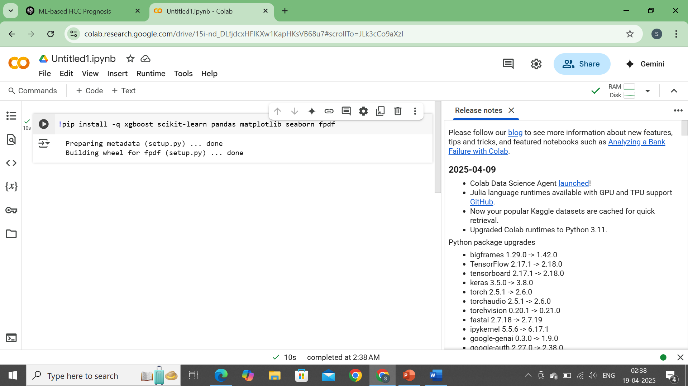
Tools Installation
!pip install -q xgboost scikit-learn pandas matplotlib seaborn fpdf

Slide 17
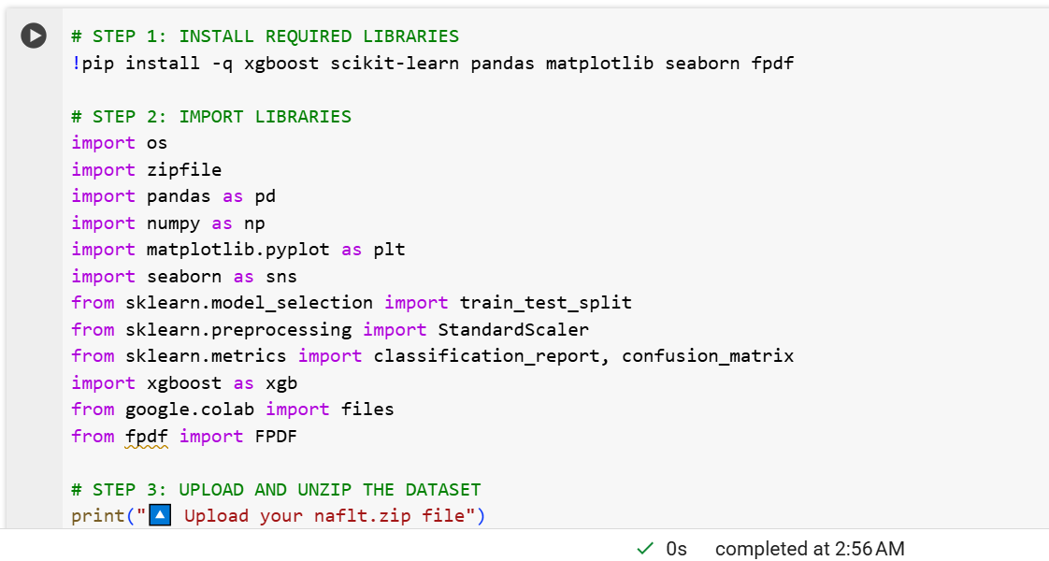
Module Implementation

Slide 18
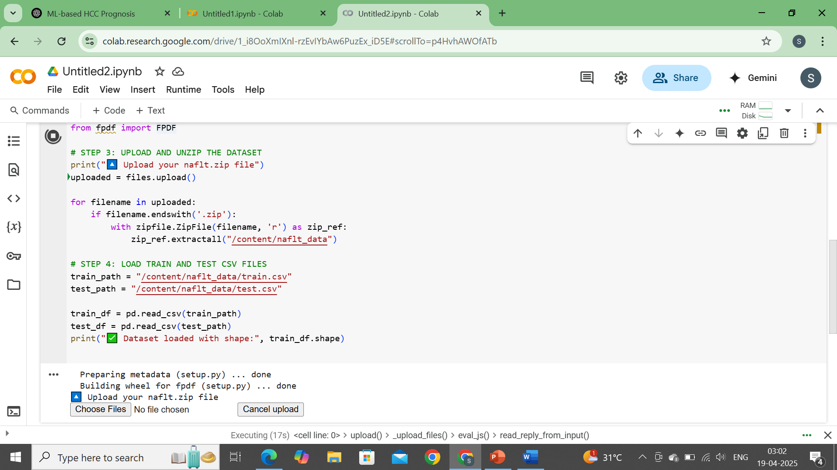
Modules Implementation(Cont…)

Slide 19
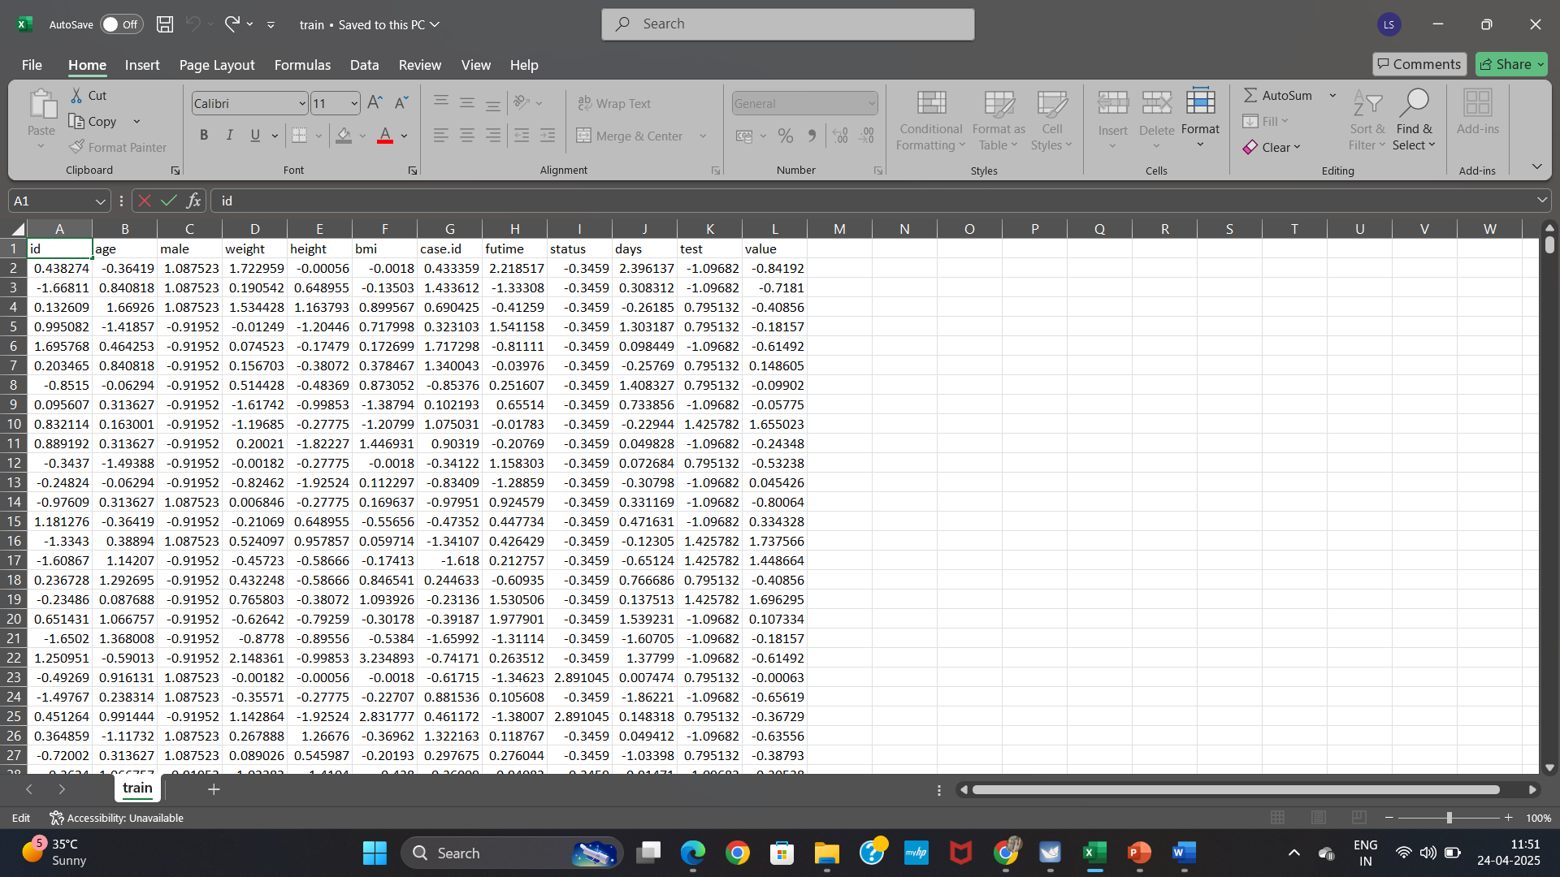
Dataset

Slide 20
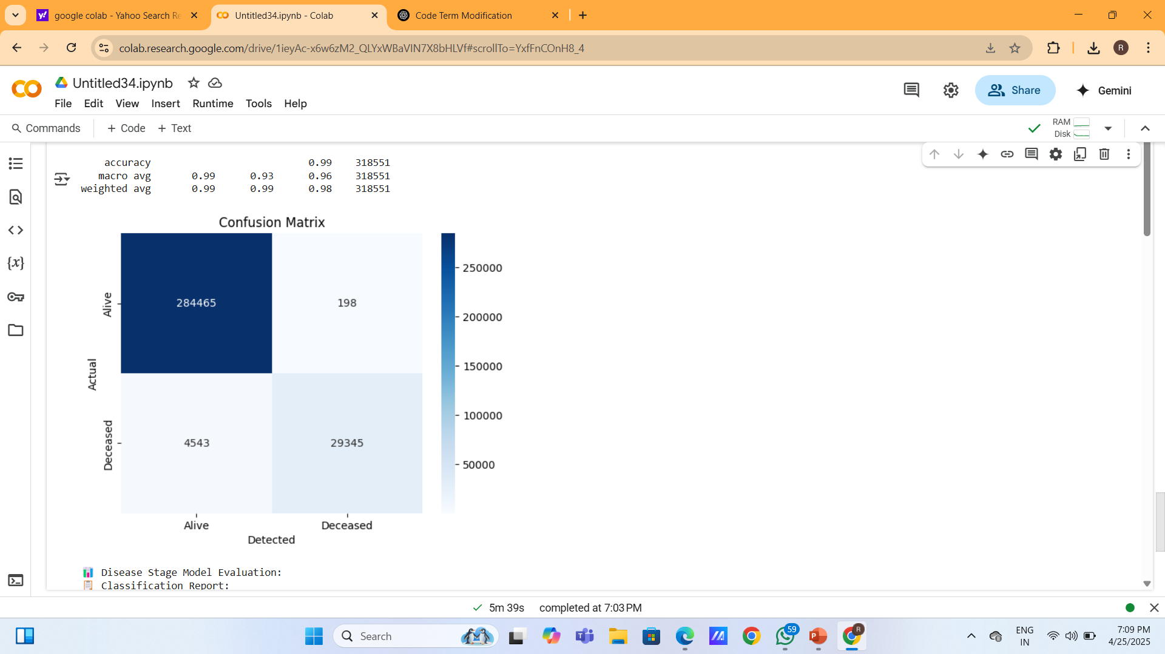
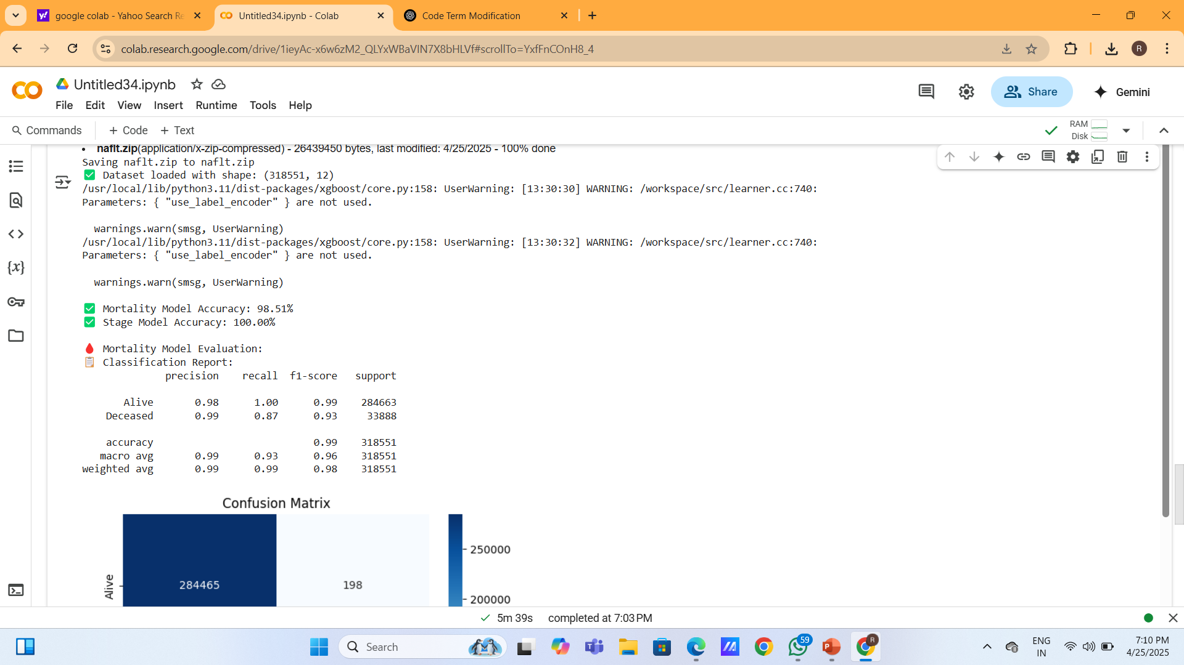
Model Evaluation

Slide 21
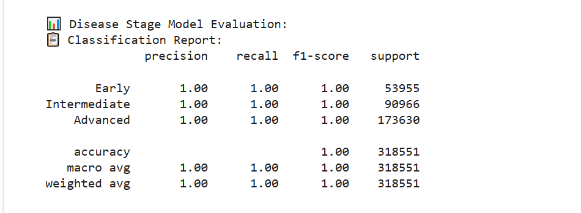
Model Evaluation(Cont..)

Slide 22
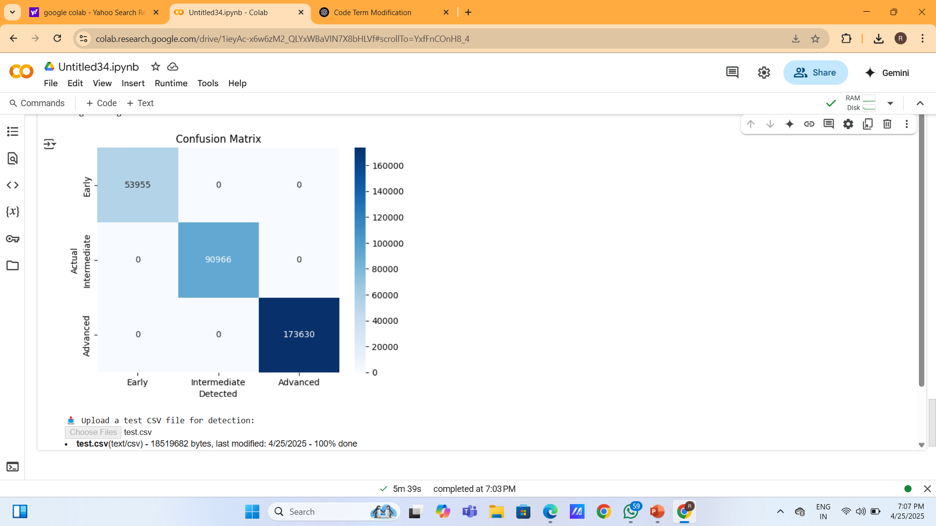
Model Evaluation(Cont..)

Slide 23
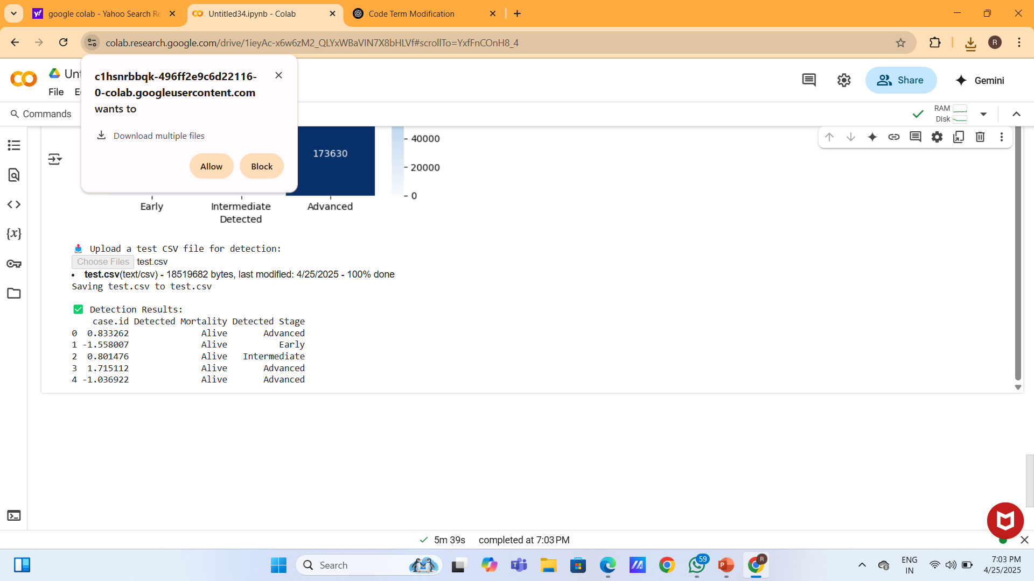
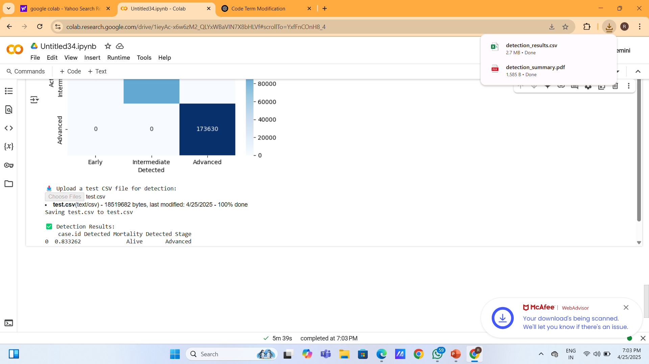
Real-Time Detection & Report Generation

Slide 24
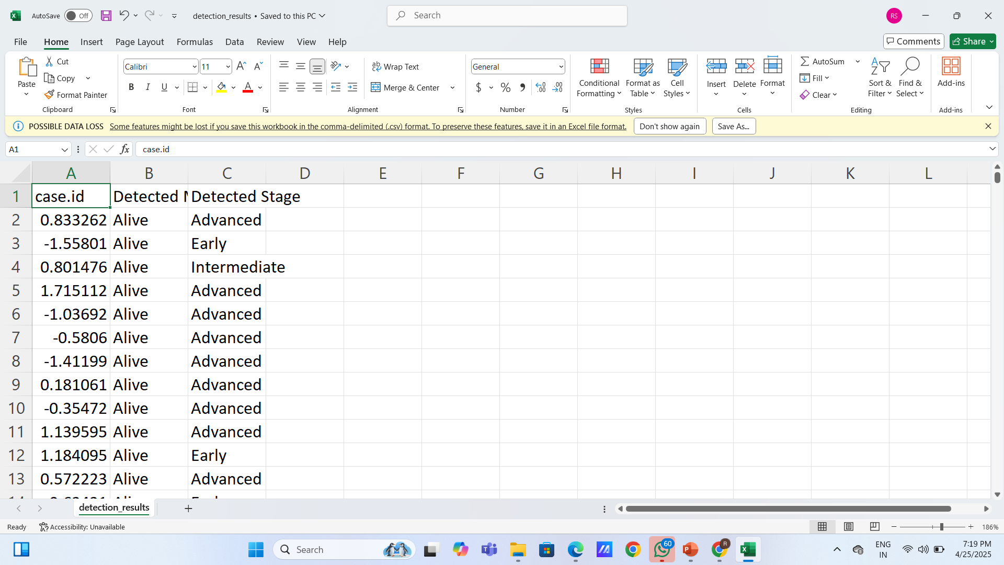
Real-Time Detection & Report Generation

Slide 25
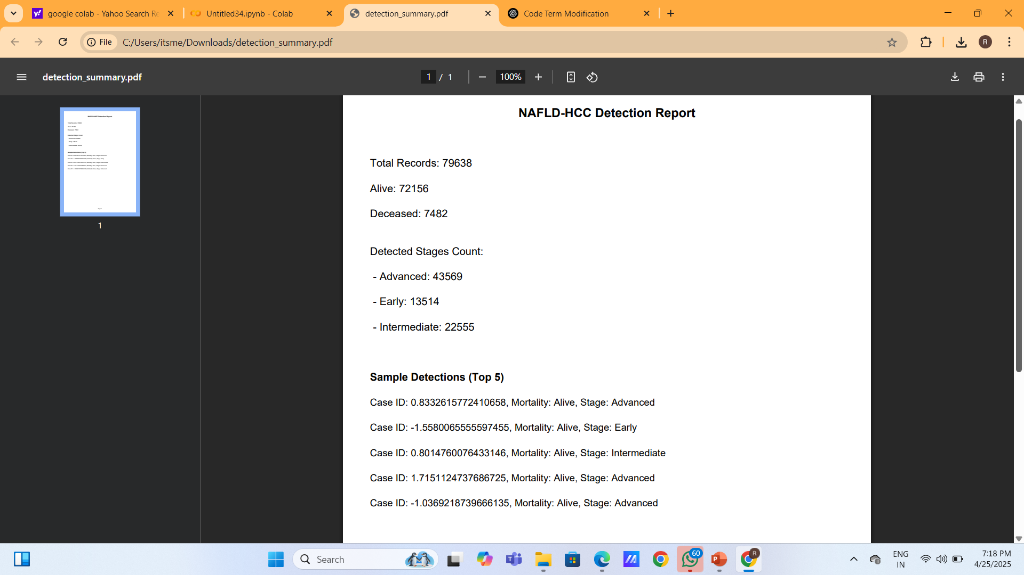
Real-Time Detection & Report Generation

Slide 26
References
Suárez, M., Gil-Rojas, S., Martínez-Blanco, P., et al.Machine Learning-Based Assessment of Survival and Risk Factors in Non-Alcoholic Fatty Liver Disease-Related Hepatocellular Carcinoma for Optimized Patient Management. Cancers 2024, 16, 1114.
Younossi, Z.M., et al. The Global Epidemiology of NAFLD and NASH: A Systematic Review. Hepatology, 77, 1335-1347.
Sagi, O., & Rokach, L. Approximating XGBoost with an Interpretable Decision Tree. Information Sciences, 572, 522-542.
Beam, A.L., & Kohane, I.S. Big Data and Machine Learning in Health Care. JAMA, 319(13), 1317-1318.

Slide 27
THANK YOU

